Slide 1


Design for sustainability and ICT:
a household prototype for waste water recycling
Fiammetta Costa (1), Marco Aureggi (1), Luciana Migliore (2), Paolo Perego (1), Margherita Pillan (1), Carlo Emilio Standoli (1), Giorgio Vignati (1)
1 Dept. of Design, Politecnico di Milano, 20158 Milan, Italy
2 Dept. of Biology, Tor Vergata University, 00133 Rome, Italy

Slide 2




The aim of this work is to experiment the application of interaction design methodologies and digital technologies to foster the transition toward sustainability. To this purpose, we developed an interactive prototype based on a domestic water recycling system drawn up with life science experts.
The aim is also to experiment a multidisciplinary approach to face environmental problems.

Slide 3
The system consists of a dishwasher integrated with an indoor planting device, where the wastewater is treated to make it available for the cultivation of vegetables or for the reuse in following washing cycles.
This new product will stimulate the development of healthier behaviours in users. In fact, the in situ production of edible plants will increase their contribution to the diet, reducing simultaneously the environmental impact due to the transport of food, produced and marketed in a standard way.

Slide 4
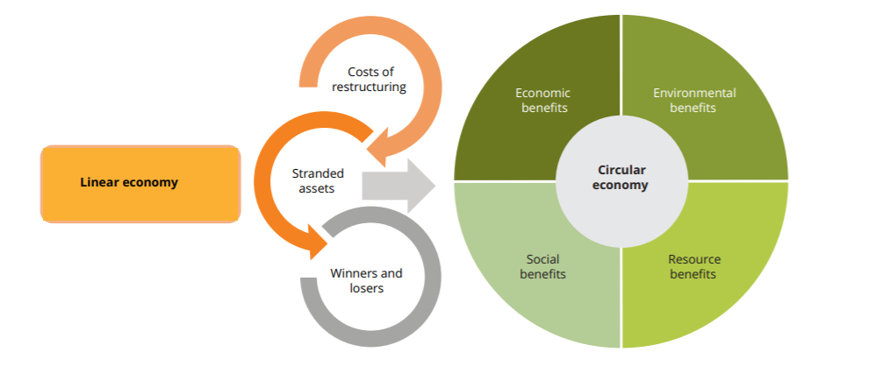
From Linear Economy to Circular Economy
Font: EEA Report No 2/2016, Circular economy in Europe. Developing the knowledge base

Slide 5
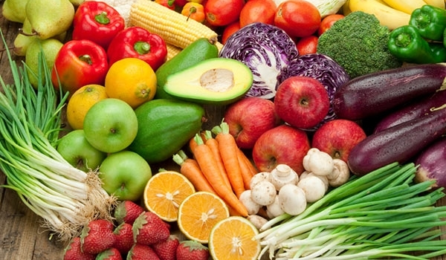
Food and sustainability
Sustainable diets are those diets with low environmental impacts which contribute to food and nutrition security and to healthy life for present and future generations. Sustainable diets are protective and respectful of biodiversity and ecosystems, culturally acceptable, accessible, economically fair and affordable; nutritionally adequate, safe and healthy; while optimizing natural and human resources.

Slide 6
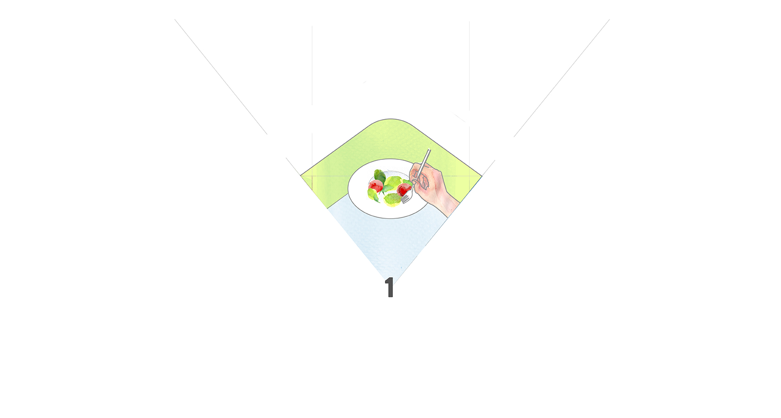

Slide 7
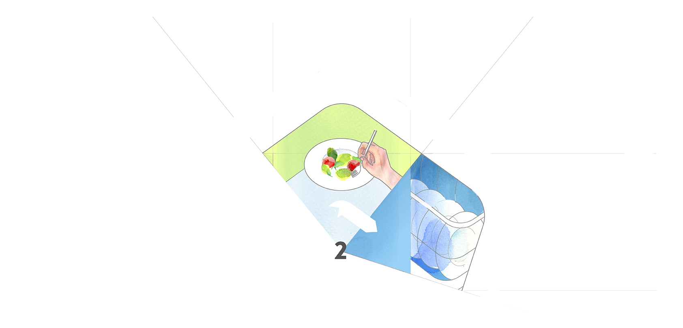

Slide 8
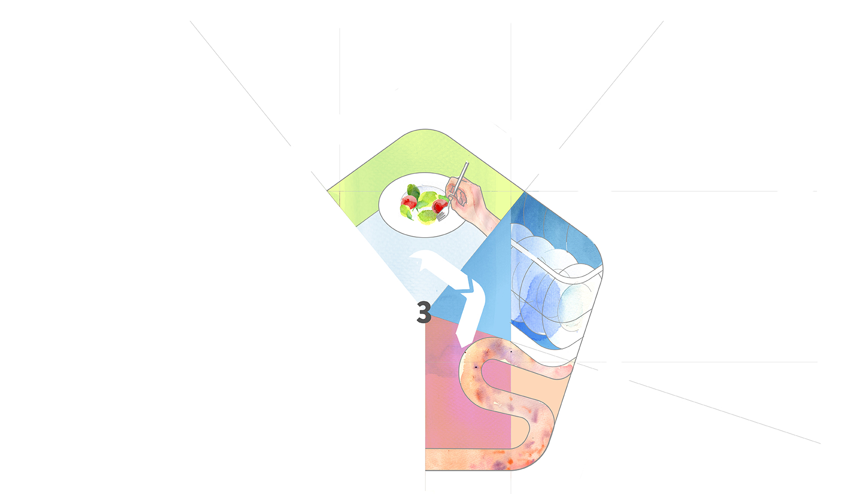

Slide 9
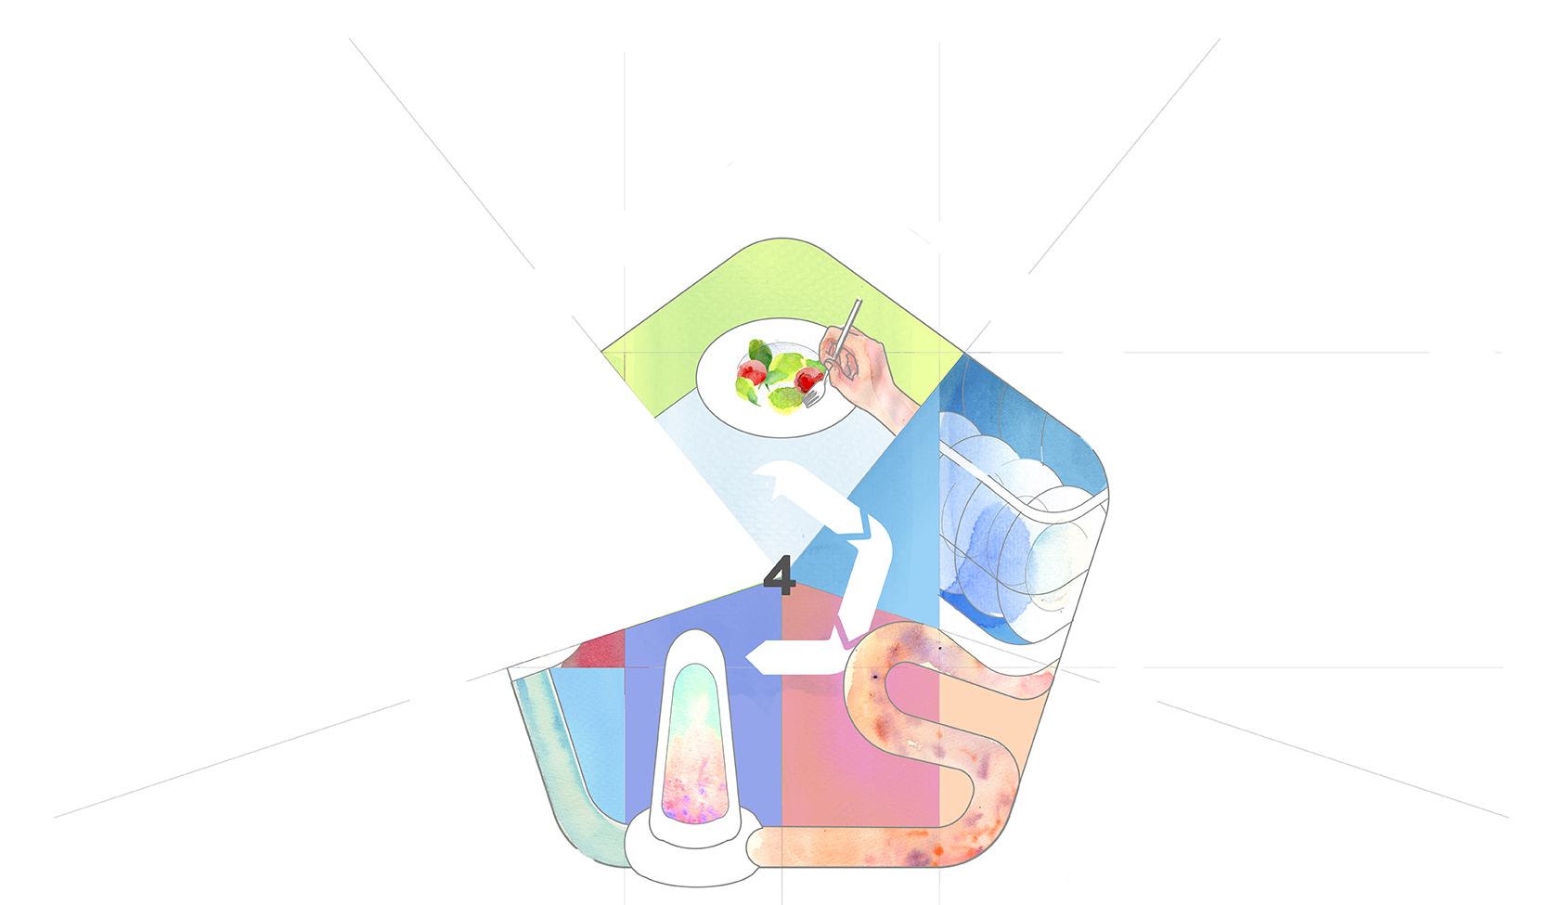

Slide 10
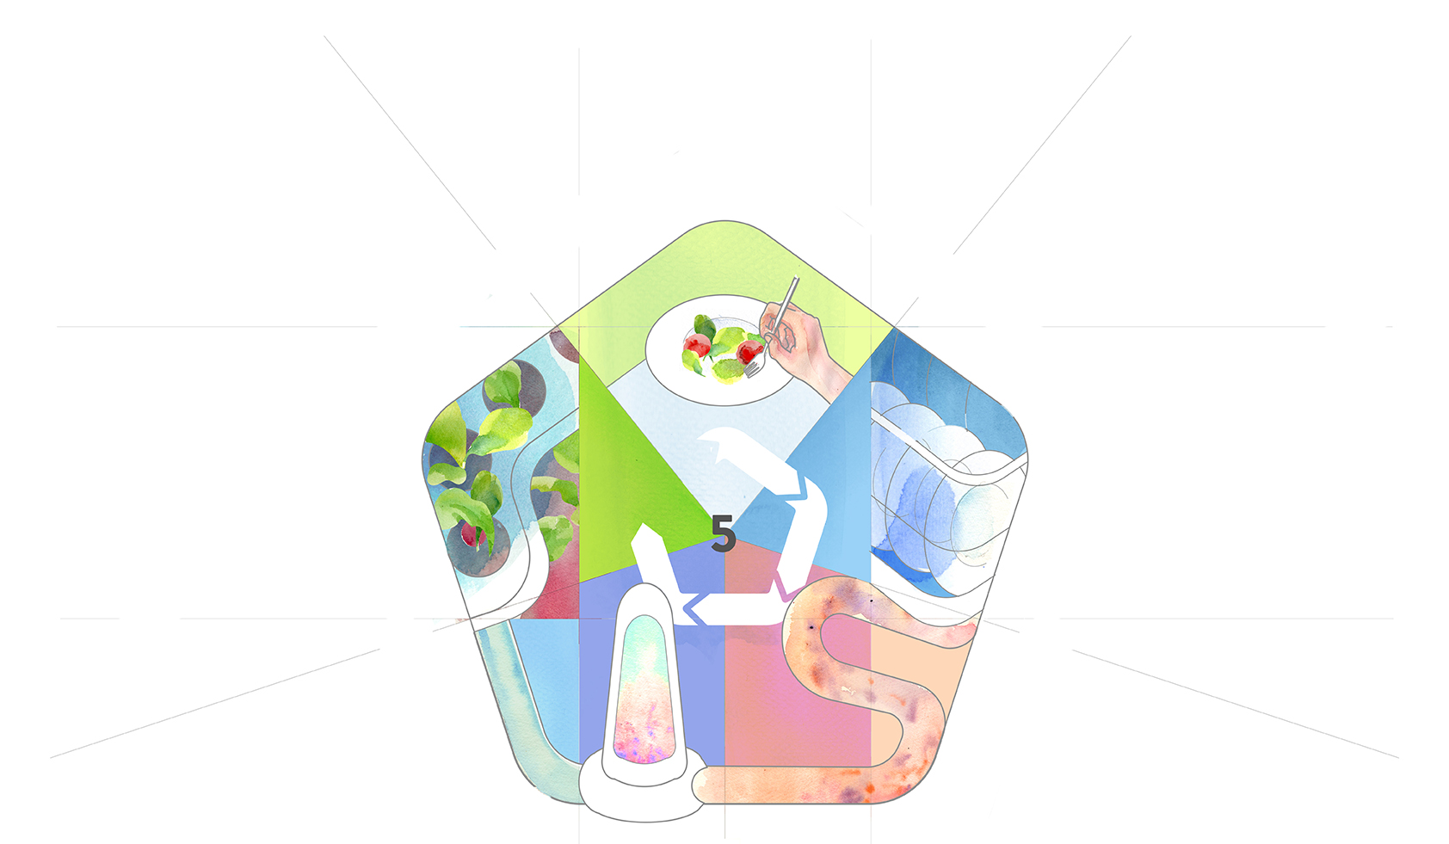

Slide 11
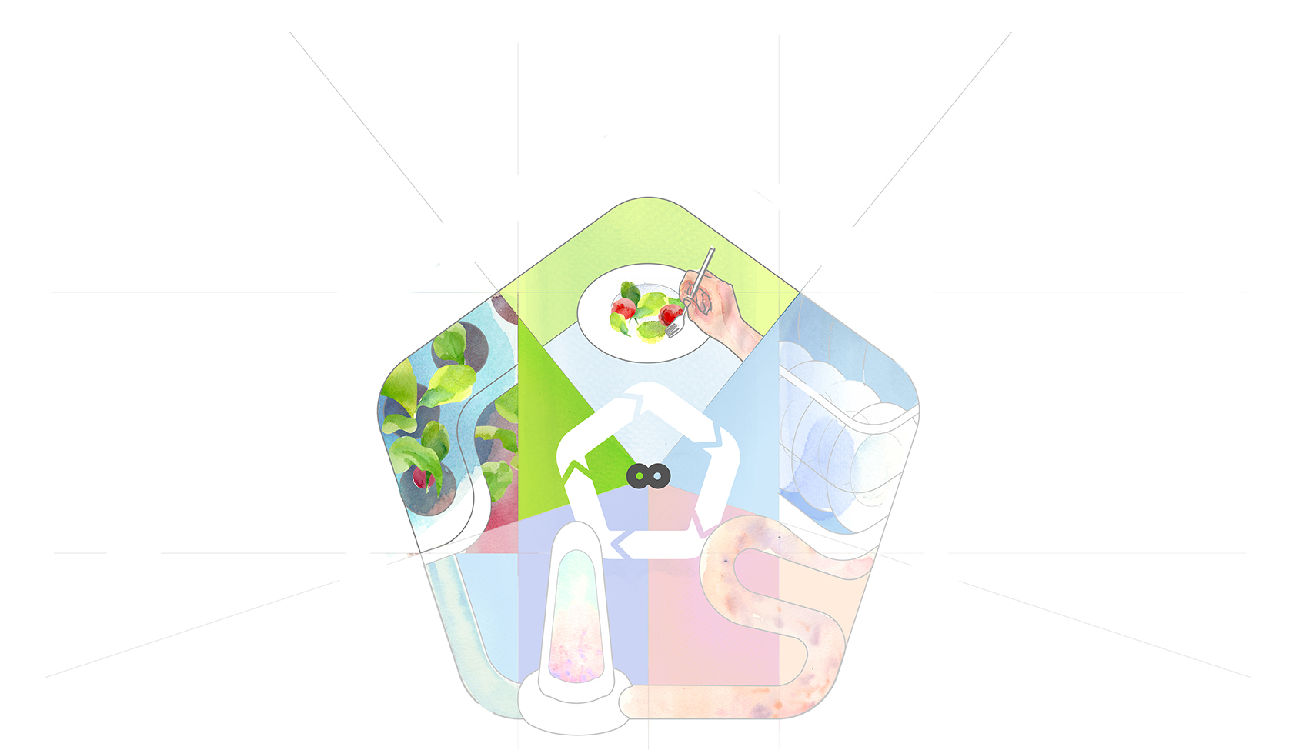

Slide 12
System description
The system consists of a dishwasher integrated with an indoor planting device, to recycle wastewater from dishwasher for two parallel purposes:
making available the organic nutrients present in waste water for the cultivation of vegetables in home environment;
reusing the recycled water for following washing cycles.

Slide 13
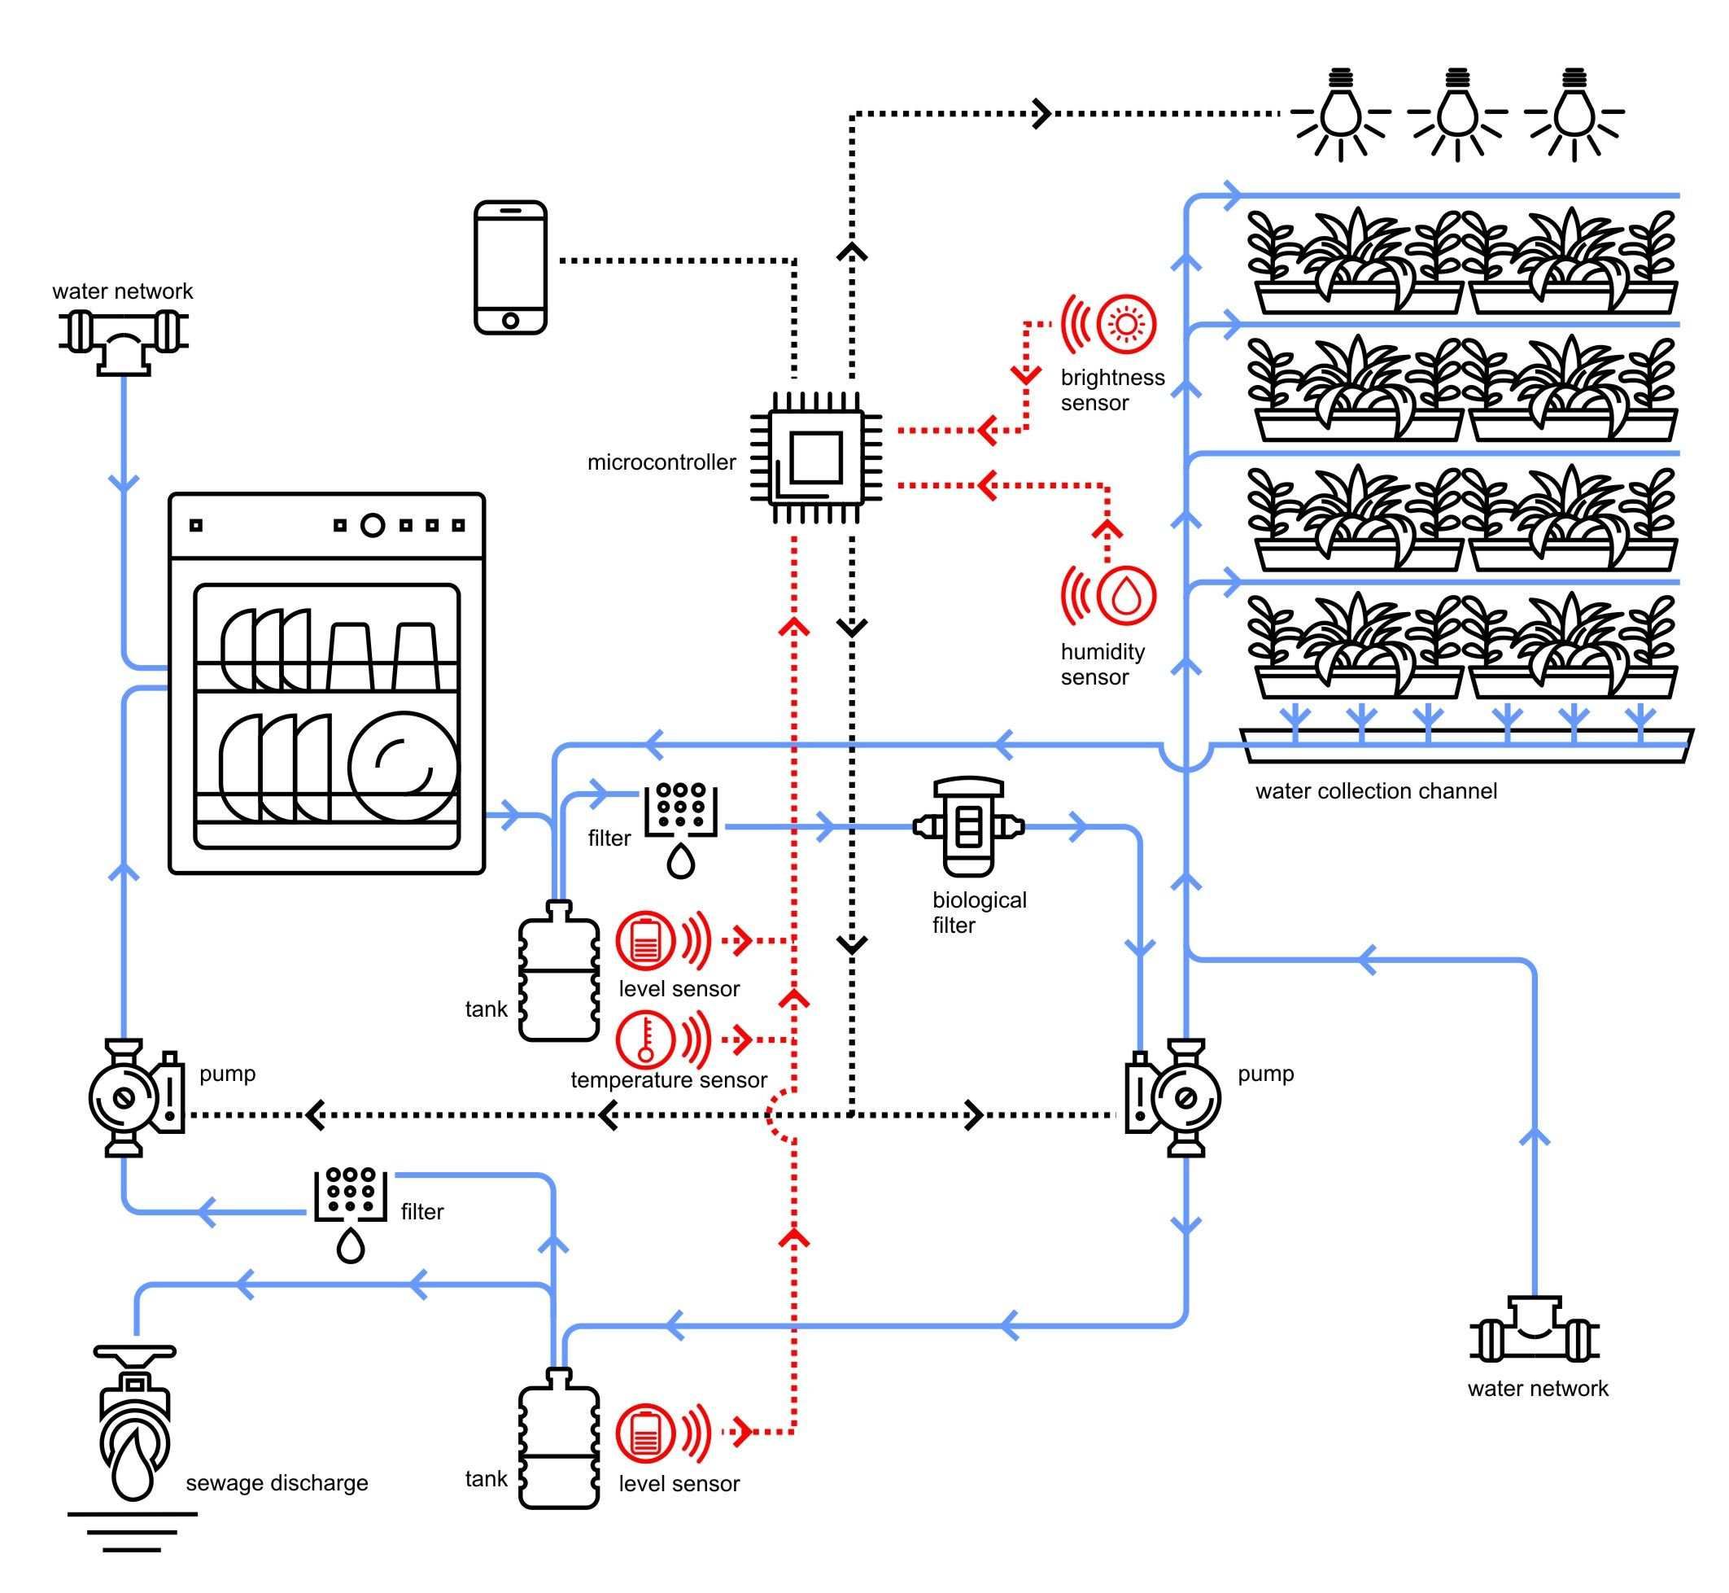

Slide 14
Research steps
benchmarking through internet-based research and field-research
consumer habits and preferences study through secondary analysis of quantitative data and focus groups with consumers and stakeholders
co-design workshop to generate the system concept
experimental prototype realization to test plants growth and user interaction
final user interface and interaction system development
user trials

Slide 15
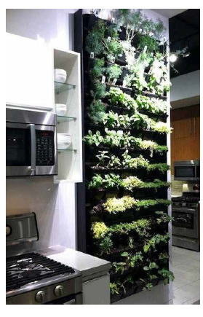
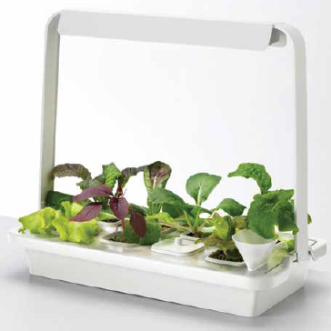
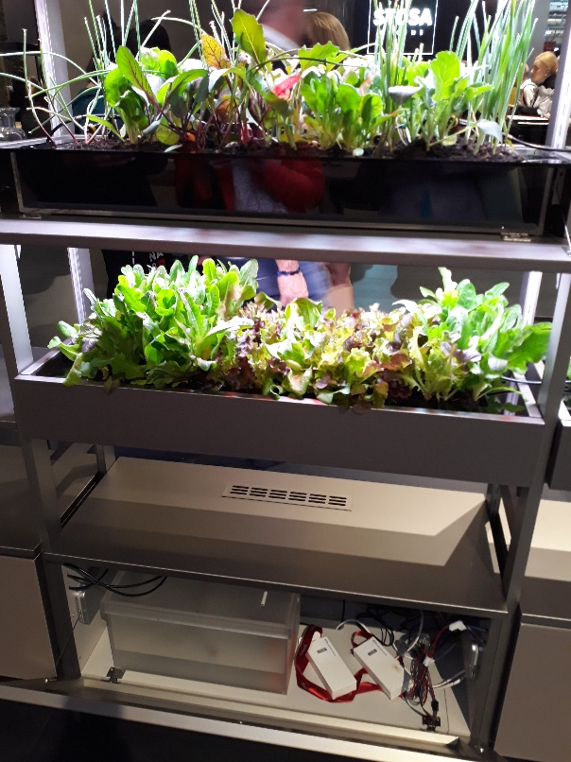
Benchmarking and field research
A. Wall system solution B. Kitchen integrated solutions C. Compact solution
A
B
C

Slide 16
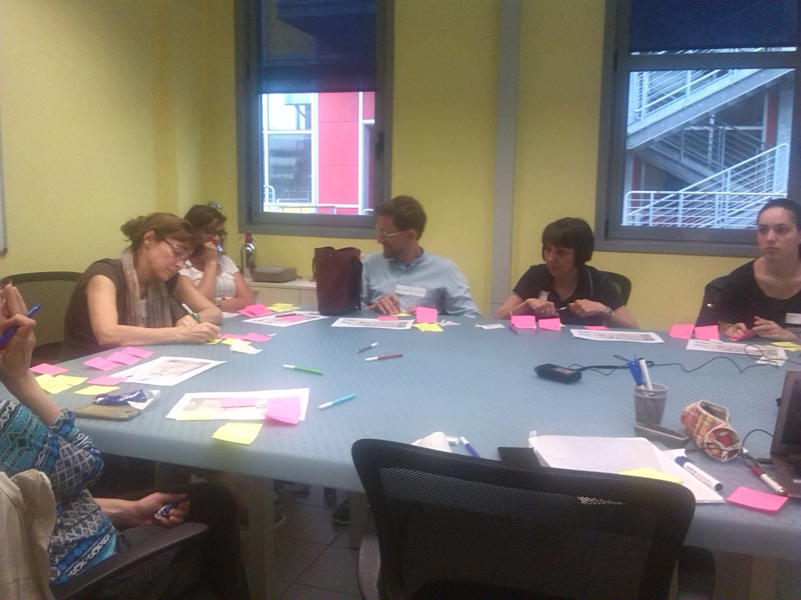
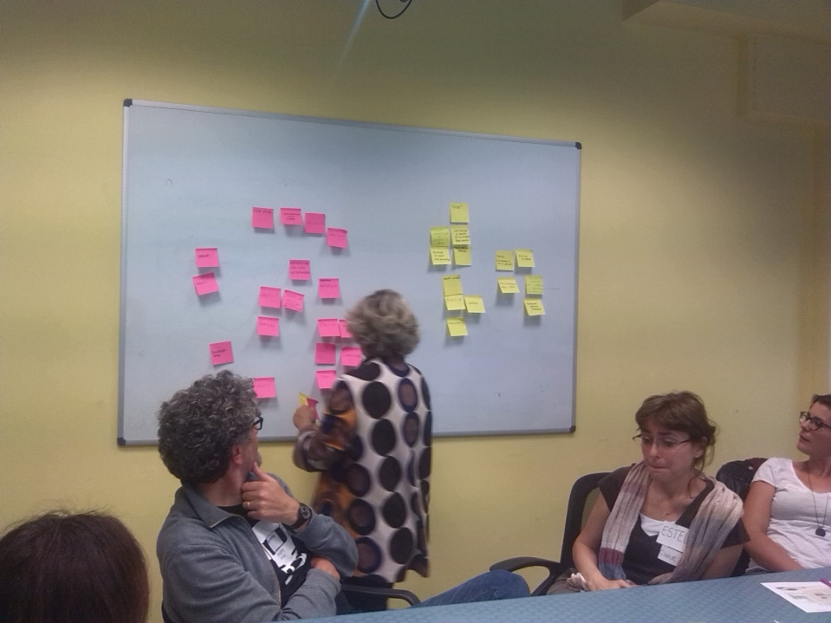
Focus group and secondary data analysis
The interviewees and focus-group showed a clear interest in sustainability issues, confessed struggling with enacting sustainable behavior.
Secondary data analysis highlighted that Italian families owning a dishwasher use it a mean of around 4 times a week

Slide 17
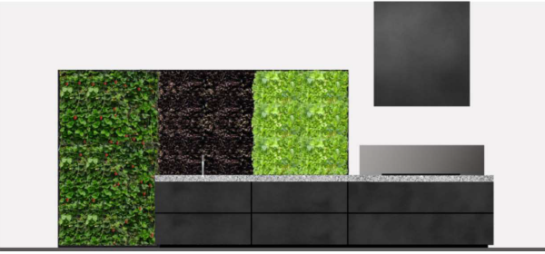
Concept
According to the results emerged during the experimental and UCD phase the system was developed.
The wall-system solution integrated into the kitchen has been chosen, as the best solution compared to those analyzed in the benchmarking phase.

Slide 18
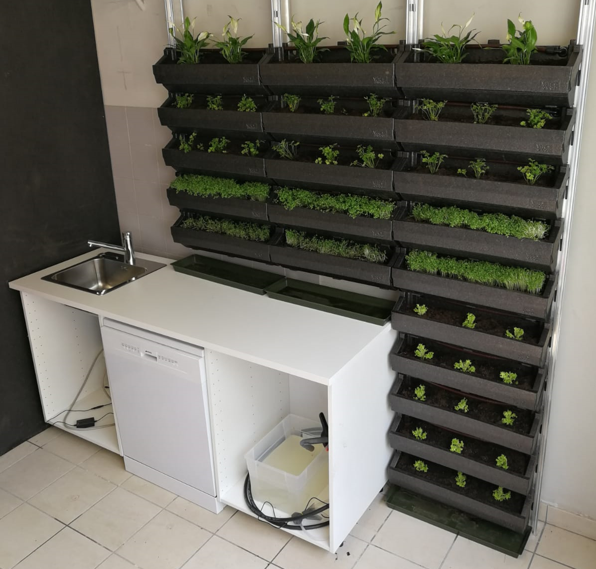
Prototype

Slide 19
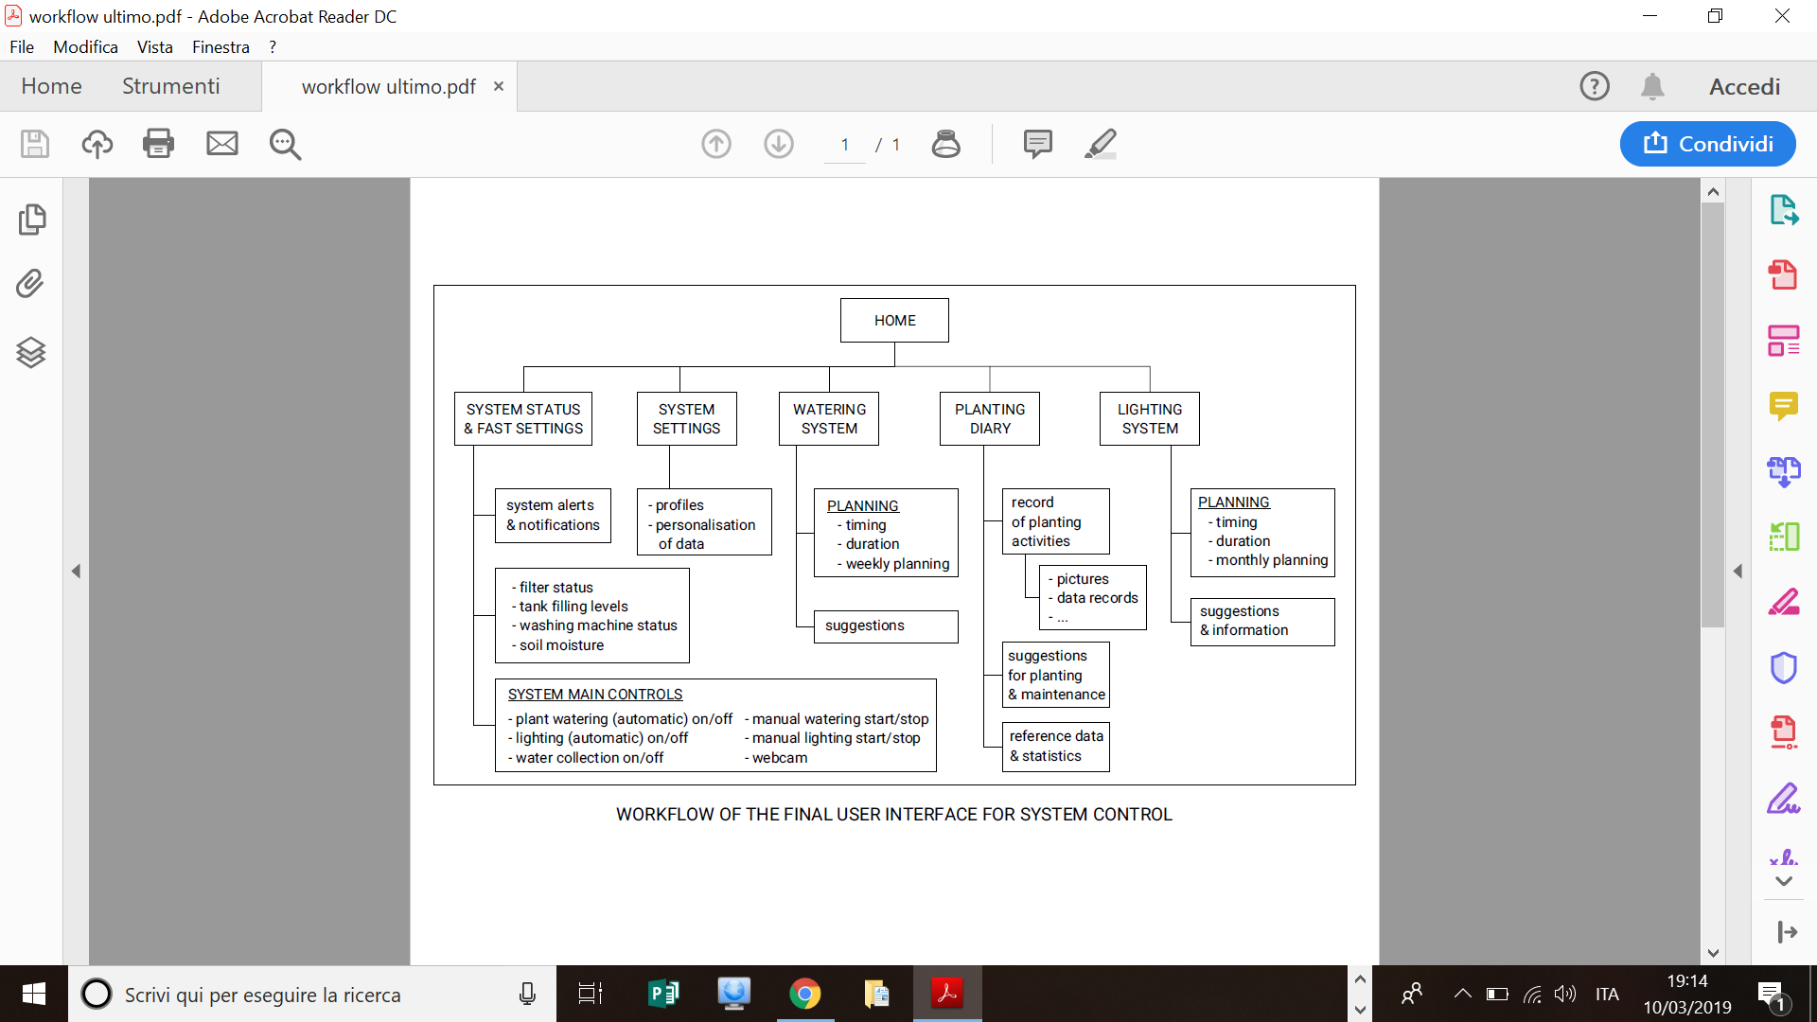
Workflow

Slide 20
Conclusions
The research is still going on and the next steps will focus on:
iterative prototyping and refinements of the digital interfaces,
investigation of the quality of the final organic products,
definition of the technical characteristics of the system.

